Slide 1
TCP可靠数据传输

Slide 2
TCP reliable data transfer
TCP creates rdt service on top of IP’s unreliable service
Pipelined segments
Cumulative acks
TCP uses single retransmission timer
Retransmissions are triggered by:
timeout events
duplicate acks
Initially consider simplified TCP sender:
ignore duplicate acks
ignore flow control, congestion control

Slide 3
TCP sender events:
data rcvd from app:
Create segment with seq #
seq # is byte-stream number of first data byte in segment
start timer if not already running (think of timer as for oldest unacked segment)
expiration interval: TimeOutInterval
timeout:
retransmit segment that caused timeout
restart timer
Ack rcvd:
If acknowledges previously unacked segments
update what is known to be acked
start timer if there are outstanding segments

Slide 4
TCP sender (simplified)
NextSeqNum = InitialSeqNum
SendBase = InitialSeqNum
loop (forever) {
switch(event)
event: data received from application above
create TCP segment with sequence number extSeqNum
if (timer currently not running)
start timer
pass segment to IP
NextSeqNum = NextSeqNum + length(data)
event: timer timeout
retransmit not-yet-acknowledged segment with
smallest sequence number
start timer
event: ACK received, with ACK field value of y
if (y > SendBase) {
SendBase = y
if (there are currently not-yet-knowledgedsegments)
start timer }
} /* end of loop forever */
Comment:
SendBase-1: last
cumulatively ack’ed byte
Example:
SendBase-1 = 71; y= 73, so the rcvr wants 73+ ; y > SendBase, so that new data is acked

Slide 5
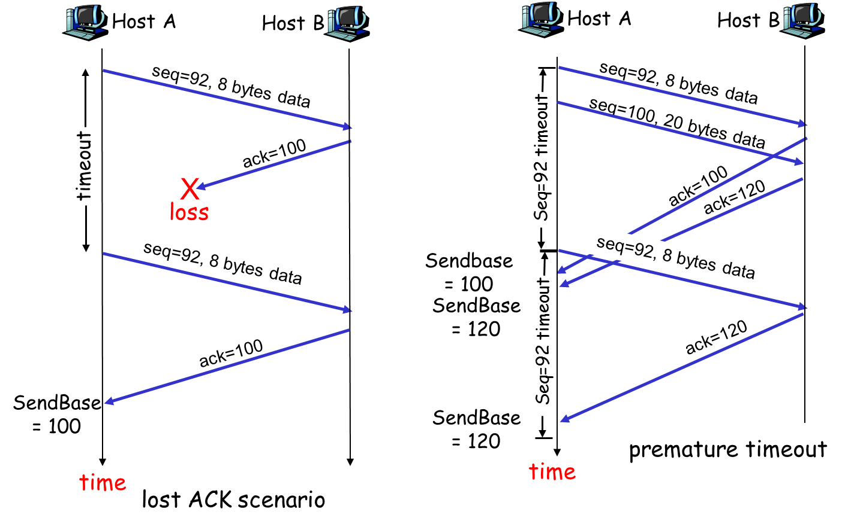
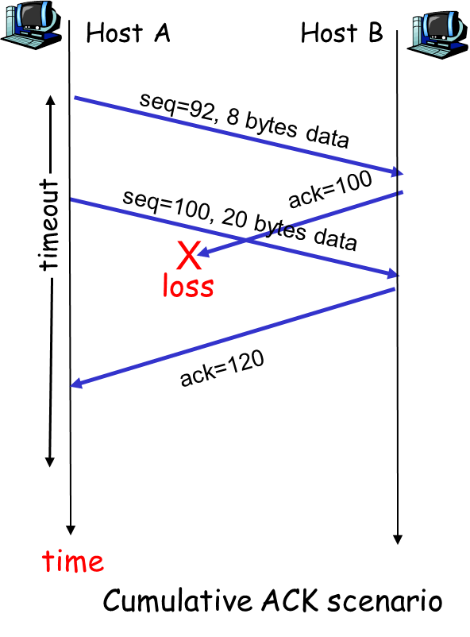
TCP: retransmission scenarios

Slide 6
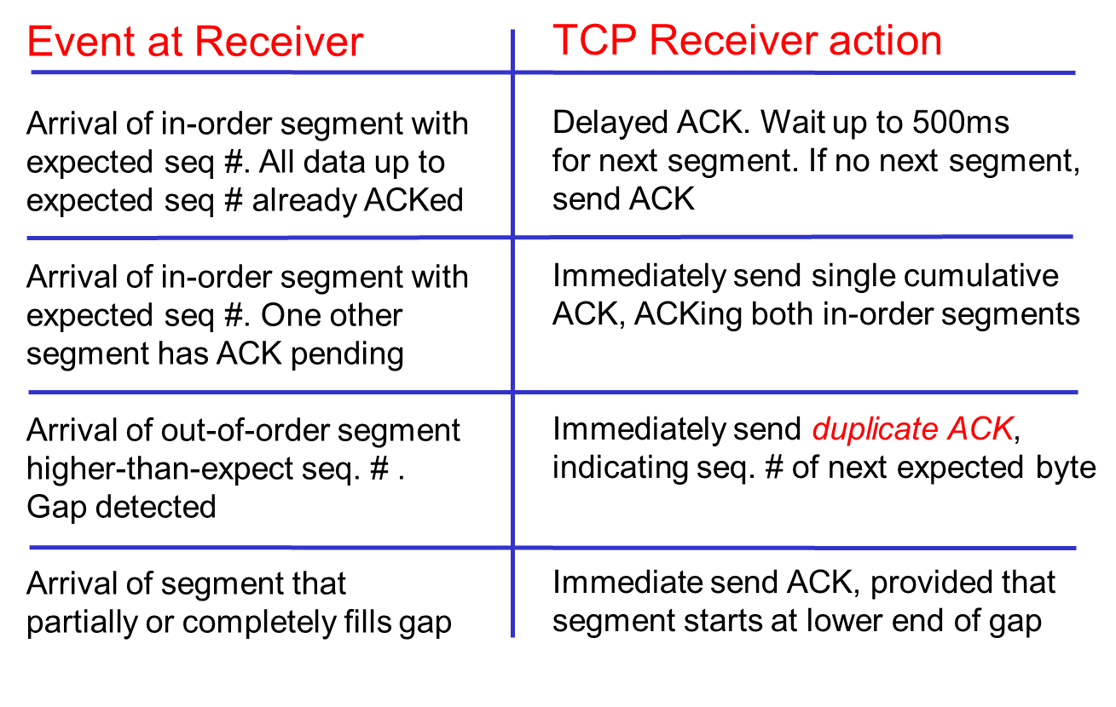
TCP ACK generation [RFC 1122, RFC 2581]

Slide 7
Fast Retransmit
Time-out period often relatively long:
long delay before resending lost packet
Detect lost segments via duplicate ACKs.
Sender often sends many segments back-to-back
If segment is lost, there will likely be many duplicate ACKs.
If sender receives 3 ACKs for the same data, it supposes that segment after ACKed data was lost:
fast retransmit: resend segment before timer expires

Slide 8
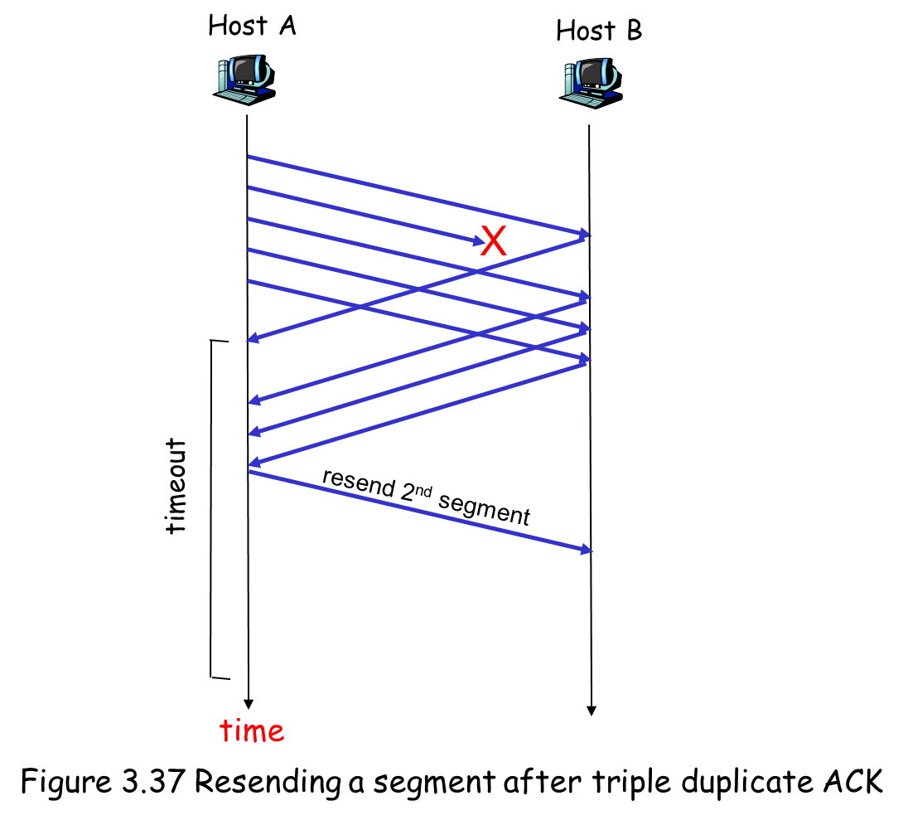
Fast Retransmit

Slide 9
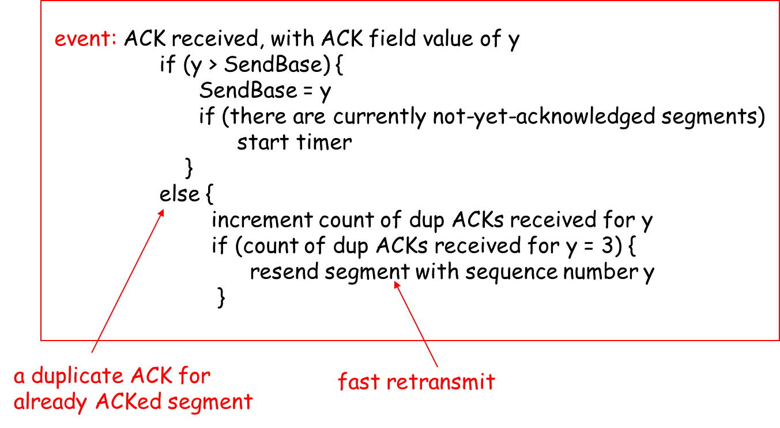
Fast retransmit algorithm:

Slide 10

Summary
TCP sender/receiver events
Fast retransmission

